Slide 2
Classification and Fairness
Hakim Qahtan
Department of Information and Computing Sciences
Utrecht University

Slide 3
Classification
Model and Data Bias
Fairness
Today

Slide 4
Classification

Slide 5
Topics
Classification
Train-Test Split
Classification Algorithms
Evaluation
Evaluation

Slide 6







Real World Examples
Spam
Credit/loan approval
Medical diagnosis
Fraud detection
Web page categorization
Spam detection in emails
Image classification
Text sentiment
Classifier
Not Spam

Slide 7

How Classifiers Work?
=
Classification is a supervised learning approach
Labeled dataset is needed
Features/Examples: X
Outcomes/Labels: Y
Learn the patterns
Use them to predict the labels
=
Learning Algorithms
Computer

Slide 8
Classification techniques
Include:
Logistic Regression
Learning from the neighbors
Decision tree-based methods
Support vector machines
Neural networks
Bayesian classification

Slide 9
Building a Classification Model
Split the data into training and testing
Train the classifier on the training data
Select a set of performance measures
Accuracy, Balanced Accuracy, Precision, Recall, F-Score, …
Evaluate the classifier on the test set
NOTE: NEVER USE THE TEST SET FOR TRAINING!

Slide 10
Train-Test Split
Random Sampling
Leave-One-Out Cross Validation
3-Fold Cross Validation

Slide 11
Train-Test Split
Problem
The training/testing set may not include examples from one of the classes
Solution
Split with stratification
Ensures that each class is represented with approximately equal proportions in both subsets

Slide 12
Classification – A Three-Step Process
Model construction
describing a set of predetermined classes
Model evaluation
testing if the model will perform well on unseen data
labels are available but not provided to the model (classifier)
Model usage
for classifying future or unknown objects

Slide 13
Model Construction
Classification
Algorithms
Training
Data
Name | Profession | Years | Buys Computer
Mike | Student | 1 | No
Mary | Professor | 7 | Yes
Bill | Professor | 2 | Yes
Jim | Student | 7 | Yes
Anne | Student | 2 | No
Dave | Student | 3 | Yes
Classifier
(Model)
IF ‘profession’ = ‘professor’
OR ‘years’ > 2
THEN ‘Buys Computer’ = ‘yes’

Slide 14
Step (2): Evaluating the Model
Classifier
(Model)
Testing
Data
Name | Rank | Years
Tom | Student | 2
Joane | Professor | 7
Greg | Professor | 1
Sally | Student | 4
prediction
Actual Labels
Name | Rank | Years | Buys Computer
Tom | Student | 2 | No
Joane | Professor | 7 | Yes
Greg | Professor | 1 | Yes
Sally | Student | 4 | Yes
Buys Computer
No
No
Yes
Yes

Slide 15
Step (3): Using the Model in Prediction
Unseen Data
Classifier
(Jeff, Professor, 4)
Buys Computer?
Yes

Slide 16
Classification Techniques

Slide 17

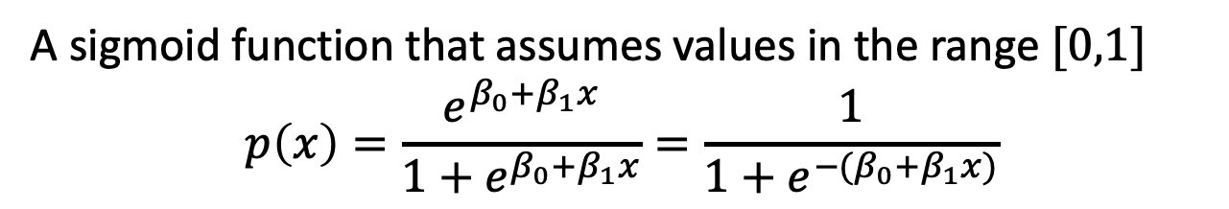
Logistic Regression
A sigmoid function that assumes values in the range $[0,1]$
$$p\left(x\right)=\frac{e^{β_{0}+β_{1}x}}{1+e^{β_{0}+β_{1}x}}=\frac{1}{1+e^{−(β_{0}+β_{1}x)}}$$

Slide 18
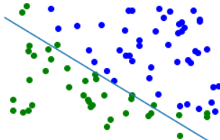
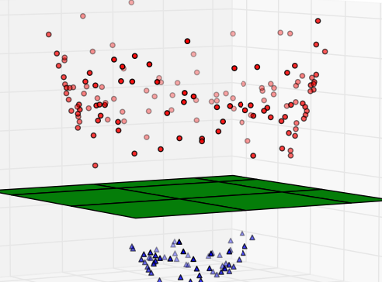
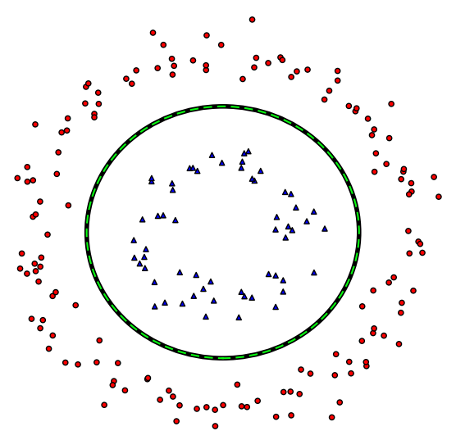
Decision Boundaries

Slide 19
Nearest Neighbors Classifiers
Basic idea: if it walks like a duck, quacks like a duck, then it is probably a duck

Slide 20
Nearest Neighbors Classifiers (Cont.)
1- nearest neighbor
2- nearest neighbors
3- nearest neighbors

Slide 21
Nearest Neighbors Classifiers (Cont.)
Unknown record
Three requirements:
Set of records (training set)
Distance metric
The number of neighbors to be considered k
Classifying unknown record x:
Compute the distance from x to the other training records
Identify the k-Nearest Neighbors (kNN(x))
Use class labels of the kNN records to determine the class of x .. How?

Slide 22
Decision Trees
age | income | student | credit_rating | buys_computer
<=30 | high | no | fair | no
<=30 | high | no | excellent | no
31…40 | high | no | fair | yes
>40 | medium | no | fair | yes
>40 | low | yes | fair | yes
>40 | low | yes | excellent | no
31…40 | low | yes | excellent | yes
<=30 | medium | no | fair | no
<=30 | low | yes | fair | yes
>40 | medium | yes | fair | yes
<=30 | medium | yes | excellent | yes
31…40 | medium | no | excellent | yes
31…40 | high | yes | fair | yes
>40 | medium | no | excellent | no
Outcome: Buys_computer
Resulting tree:
age?
<=30
31..40
>40
student?
yes
Credit_rating?
no
yes
excellent
fair
no
yes
no
yes

Slide 23
Random Forests
Four legs?
Wings?
Wild?
Snake
Bird
Barks?
Lay eggs?
Cat
Dog
Tiger
Turtle

Slide 24
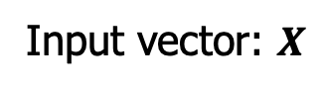
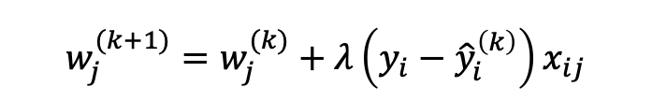
Neural Network
Output vector
Output layer
$$w_{j}^{(k+1)}=w_{j}^{(k)}+λ\left(y_{i}−{\hat{y}}_{i}^{\left(k\right)}\right)x_{ij}$$
Hidden layer
Input layer
Input vector: $X$

Slide 25
Support Vector Machines (SVM)
Find linear hyperplane (decision boundary) that will separate the data
One possible separators

Slide 26
Support Vector Machines (SVM) (Cont.)
Another possible separator
Other possible separators

Slide 27
Support Vector Machines (SVM) (Cont.)
Find the hyperplane that maximizes the margin
Better separator
Support Vectors
are the points that the margin is pushed up against

Slide 28
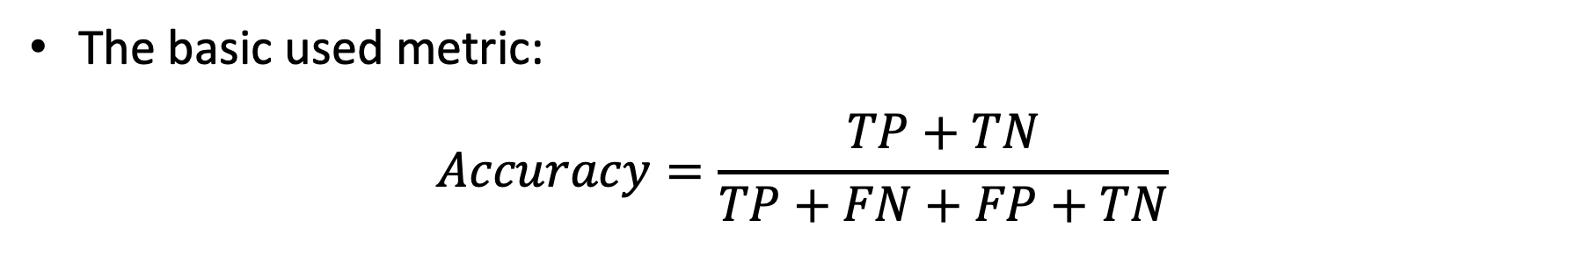
Evaluation: Confusion Matrix
Focus on the predictive capability of a model
Confusion Matrix:
 | Predicted Label
 |  | Class = Y | Class = N
Actual Label | Class = Y | TP | FN
 | Class = N | FP | TN
TP = True Positive
FP = False Positive
FN = False Negative
TN = Ture Negative
The basic used metric:
$$Accuracy=\frac{TP+TN}{TP+FN+FP+TN}$$

Slide 29
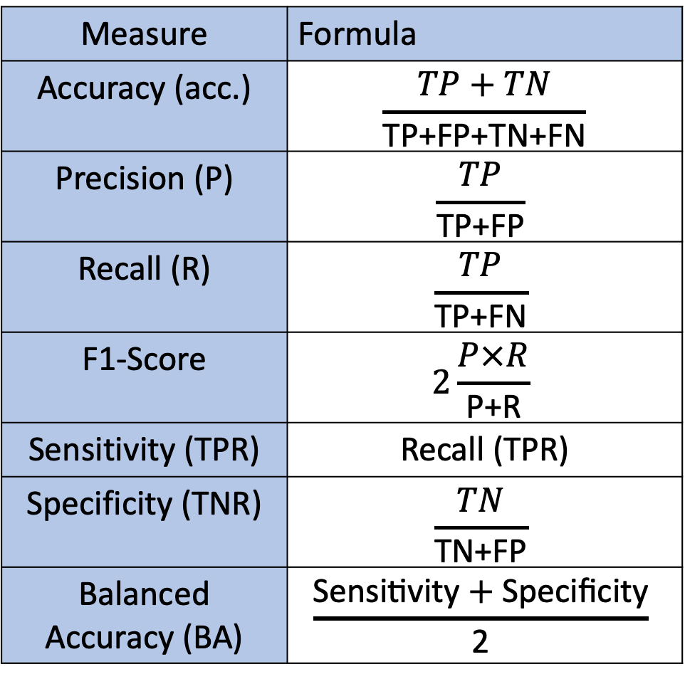
Measure | Formula
Accuracy (acc.) | $$\frac{TP+TN}{\text{TP}\text{+}\text{FP}\text{+}\text{TN}\text{+}\text{FN}}$$
Precision (P) | $$\frac{TP}{\text{TP}\text{+}\text{FP}}$$
Recall (R) | $$\frac{TP}{\text{TP}\text{+}\text{FN}}$$
F1-Score | $$2\frac{P×R}{\text{P}\text{+}\text{R}}$$
Sensitivity (TPR) | Recall (TPR)
Specificity (TNR) | $$\frac{TN}{\text{TN}\text{+}\text{FP}}$$
Balanced Accuracy (BA) | $$\frac{\text{Sensitivity}+\text{Specificity}}{\text{2}}$$
Evaluation Measures

Slide 30
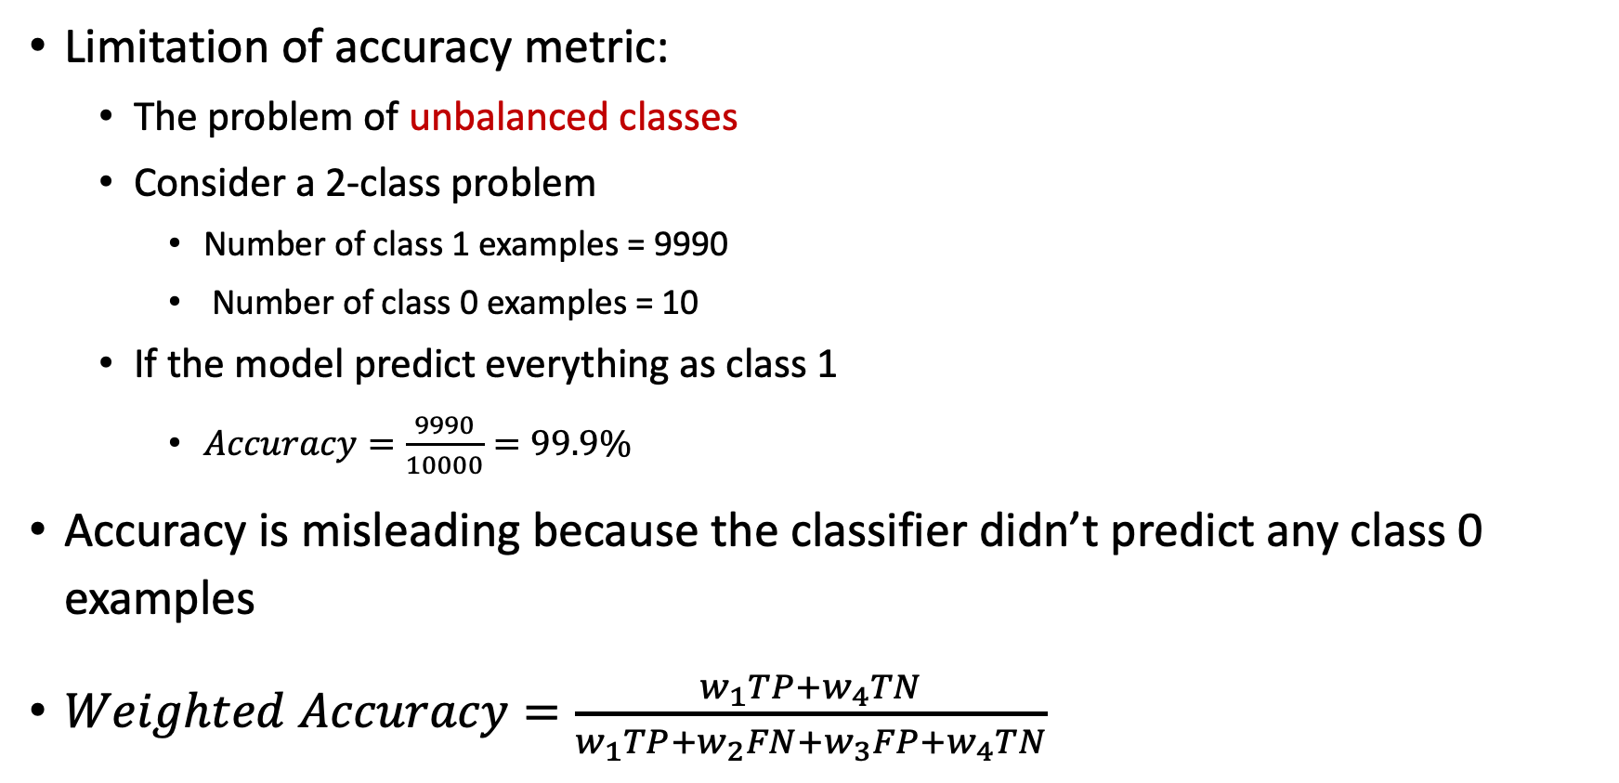
Accuracy
Limitation of accuracy metric:
The problem of unbalanced classes
Consider a 2-class problem
Number of class 1 examples = 9990
Number of class 0 examples = 10
If the model predict everything as class 1
$Accuracy=\frac{9990}{10000}=99.9\%$
Accuracy is misleading because the classifier didn’t predict any class 0 examples
$Weighted Accuracy=\frac{w_{1}TP+w_{4}TN}{w_{1}TP+w_{2}FN+w_{3}FP+w_{4}TN}$

Slide 31

Example: Classifying hand-written digits

Slide 32

Coding Time

Slide 33

Coffee Break

Slide 34
Model and Data Bias

Slide 35

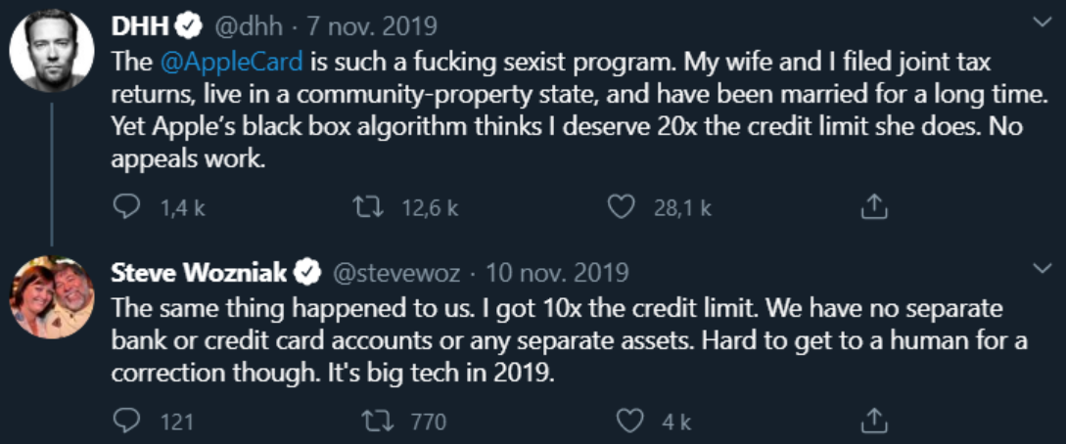
Unfair Algorithms – Apple Card
https://www.bloomberg.com/opinion/articles/2019-11-11/is-the-apple-and-goldman-sachs-credit-card-sexist, https://www.theguardian.com/technology/2019/nov/10/apple-card-issuer-investigated-after-claims-of-sexist-credit-checks

Slide 36
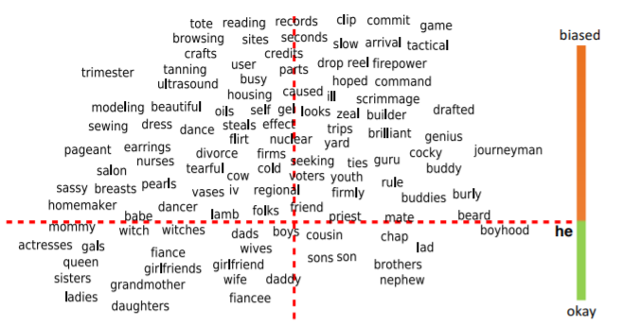
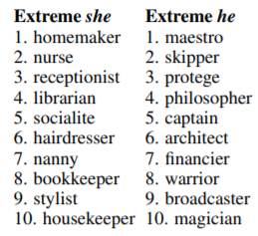
Unfair Algorithms – Word Embeddings in NLP
she
Bolukbasi, T., Chang, K. W., Zou, J., Saligrama, V., & Kalai, A. (2016). Man is to computer programmer as woman is to homemaker? debiasing word embeddings. NIPS’16.

Slide 37
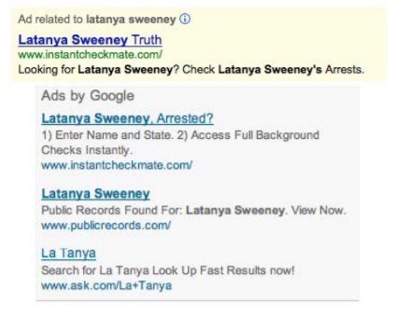
Unfair Algorithms – Google Advertisements
In the advertisement section of Google in search results:
Sexual bias against females via job ads
Racial bias against African-American and Latin people based on names
Later Google worked on these issues
Latanya Sweeney. “Discrimination in online ad delivery”. In: Communications of the ACM 56.5 (2013), pages 44–54.

Slide 38
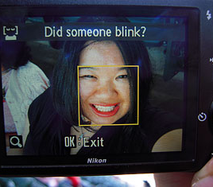
Unfair Algorithms – Nikon Smart Cameras
Racial bias while providing service:
Nikon’s facial recognition algorithm in smart cameras
Failed at recognizing the eyes of Asian people
Later fixed by Nikon
Adam Rose. “Are Face-Detection Cameras Racist?” In:TIME(Jan. 2010).url:http://content.time.com/time/business/article/0,8599,1954643,00.html.

Slide 39
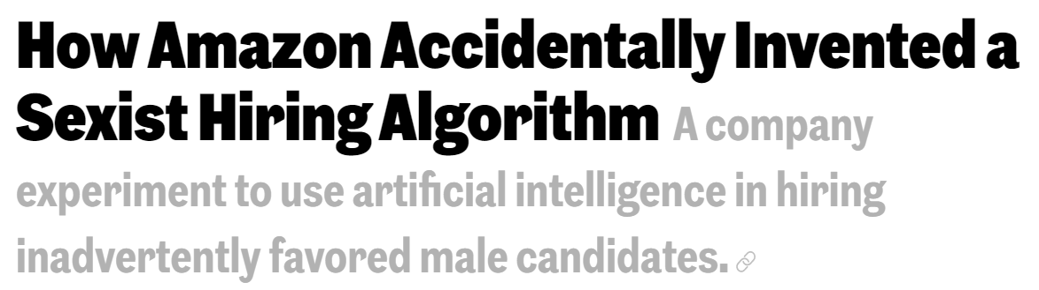
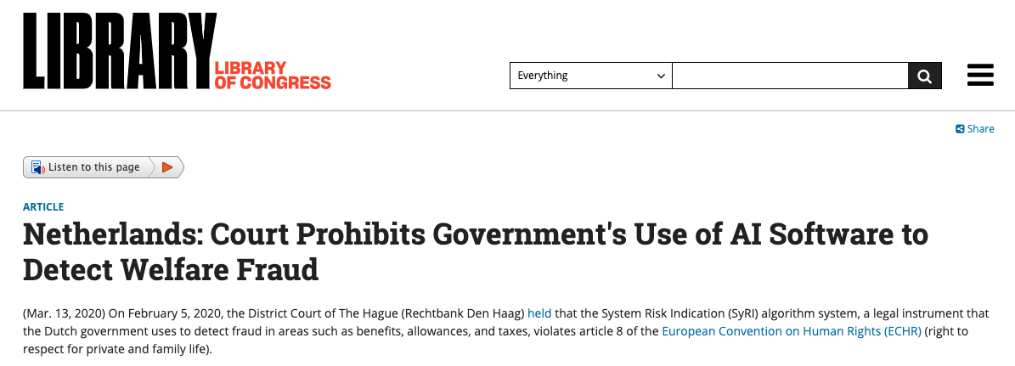
More Examples
https://www.inc.com/guadalupe-gonzalez/amazon-artificial-intelligence-ai-hiring-tool-hr.html#:~:text=Amazon%20discovered%20a%20problem%20with,the%20best%20candidates%2C%20Reuters%20reports.
https://www.loc.gov/item/global-legal-monitor/2020-03-13/netherlands-court-prohibits-governments-use-of-ai-software-to-detect-welfare-fraud/

Slide 40
Reasons
Historical bias in the decision variable
Limited / less informative features
Biased data collection
Imbalanced representation of different demographic groups

Slide 41
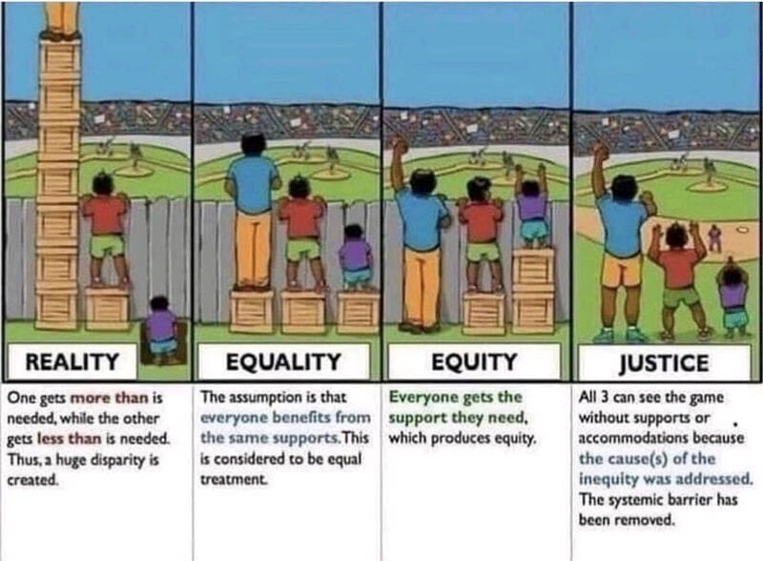
Consequences
One gets more than is needed
Huge disparity is created

Slide 42
What Should be Done?
Equality: everyone benefits from the same support
Equity: everyone gets the needed support
Justice: remove the causes of inequity

Slide 43
Fairness

Slide 44
What do you think is fair?

Slide 45
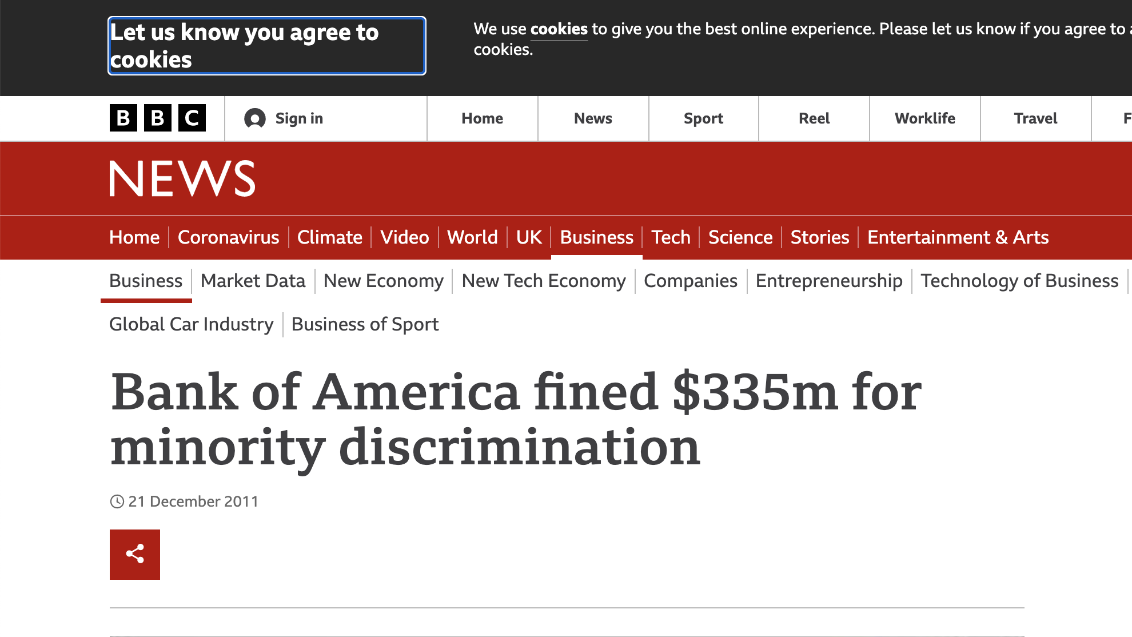
https://www.bbc.com/news/business-16296146

Slide 46
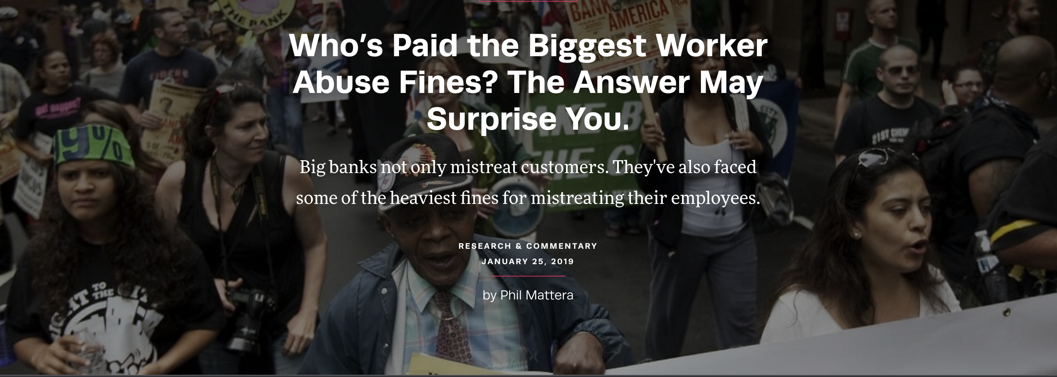
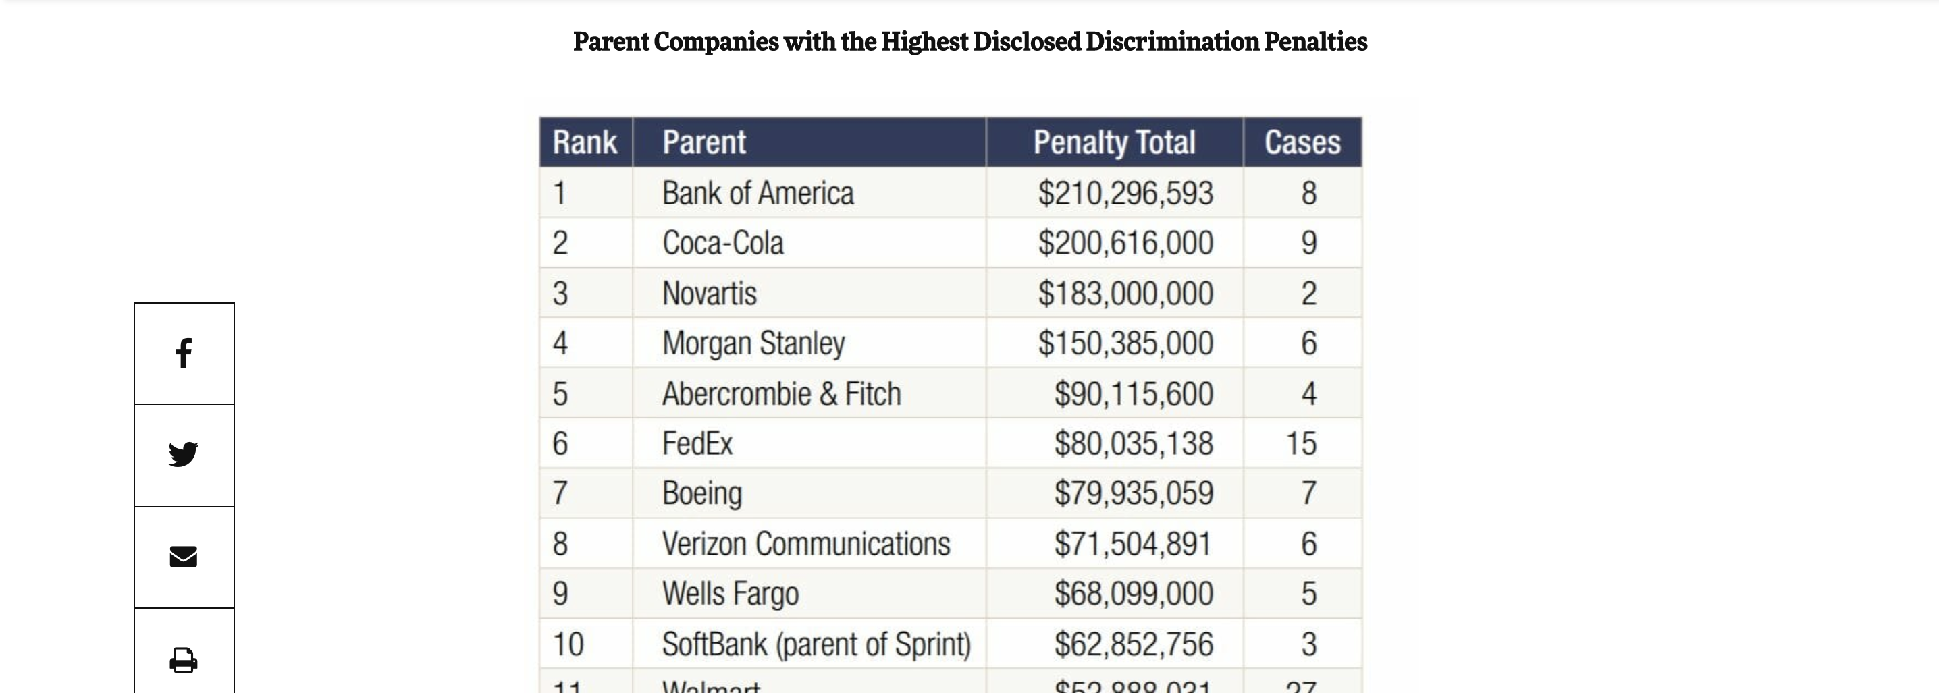
https://inequality.org/research/penalties-workplace-abuse/

Slide 47
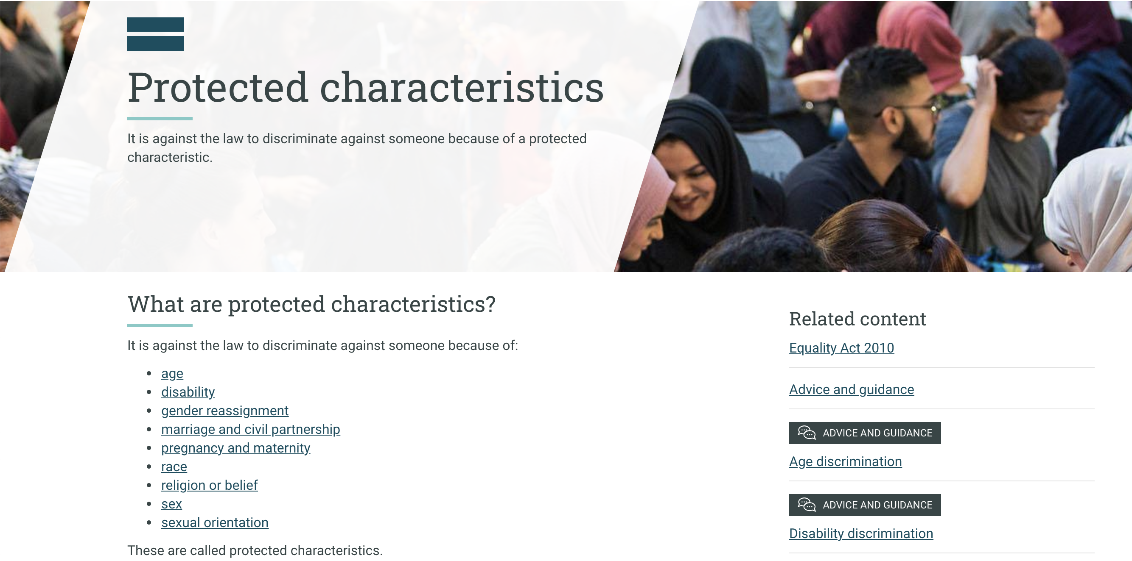
Protected Attributes
https://www.equalityhumanrights.com/en/equality-act/protected-characteristics

Slide 48
What is Fairness?
“Fairness is the absence of any prejudice or favoritism towards an individual or a group based on their intrinsic or acquired traits in the decision-making context”

Slide 49
Fairness Through Unawareness
What if you do not even collect sensitive data?
Useful to have the sensitive features to check for fairness
Removing features does not always work
Proxies

Slide 50
Statistical Parity
People of different groups should have the same probability of getting the positive outcome
Disparate Impact Ratio
Base rate unprivileged / base rate privileged
Should be between 0.8 and 1.25

Slide 51


Consistency
Priv. Pos.
An individual fairness measure
Determines how similar the labels are for the similar instances in a dataset based on the k-neighbors of the instance
This Metric: takes values between 0 and 1 with 1 is the optimal
Priv. Neg.
Un-Priv. Neg.
Un-Priv. Pos.

Slide 52
Bias Mitigation Algorithms
Pre-Processing Algorithms
In-Processing Algorithms
Post-Processing Algorithms

Slide 53
Coding Time

Slide 54

Wrap-Up
Summerize what you learned today in 2-minutes

